Slide 1

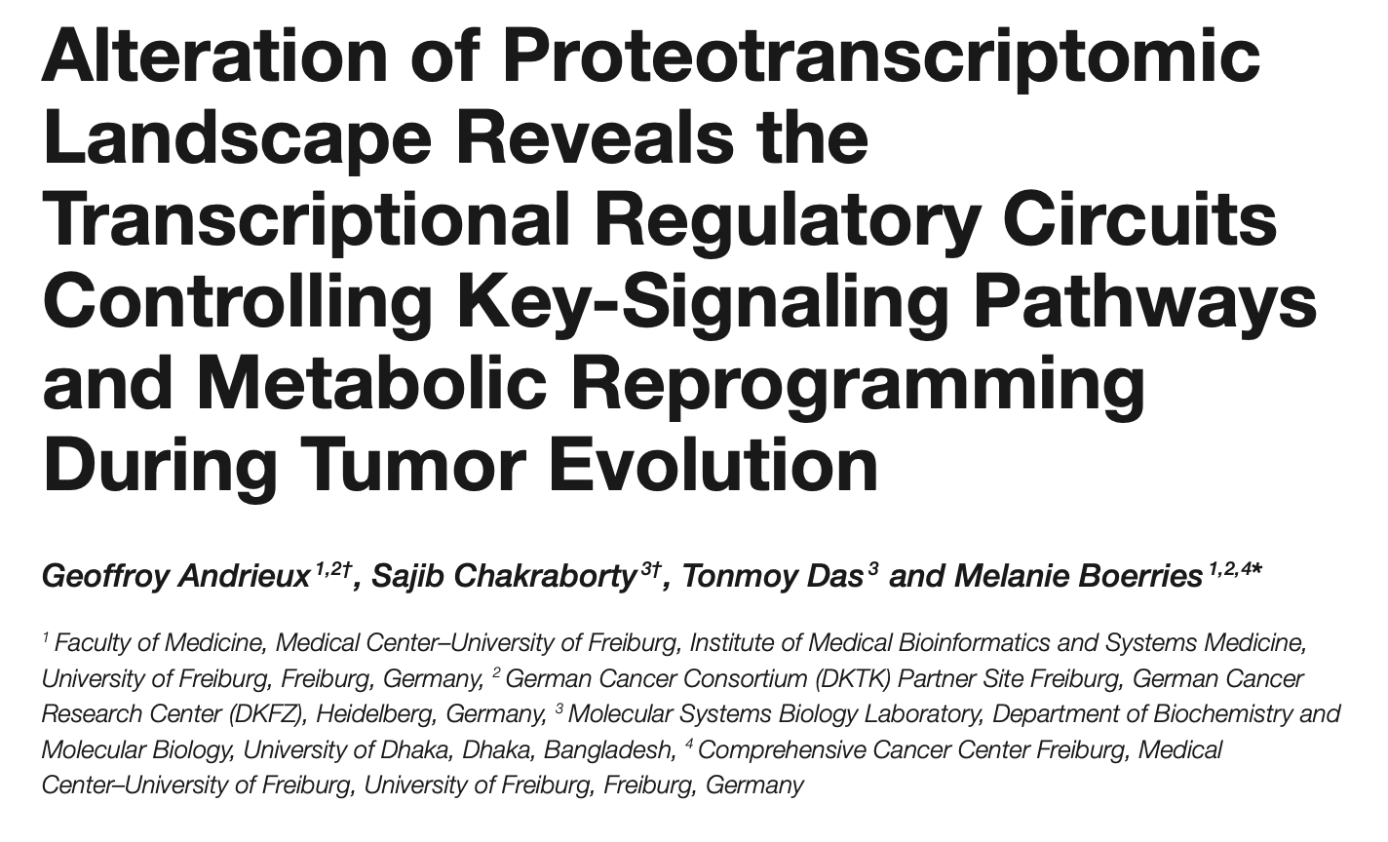
Paper Presentation | 11th of February 2021 Christina Morgenstern
Research in Biotechnology BIOL 51200 christinamorgenstern@lewisu.edu
Quelle: www.biokon.de

Slide 2

Research goal
Using a multi-omics integration study of transcriptomic and proteomic data, Andrieux et al. aimed at investigating the stability and correlation between mRNA and protein in different murine and human healthy and tumor tissues.

Slide 3
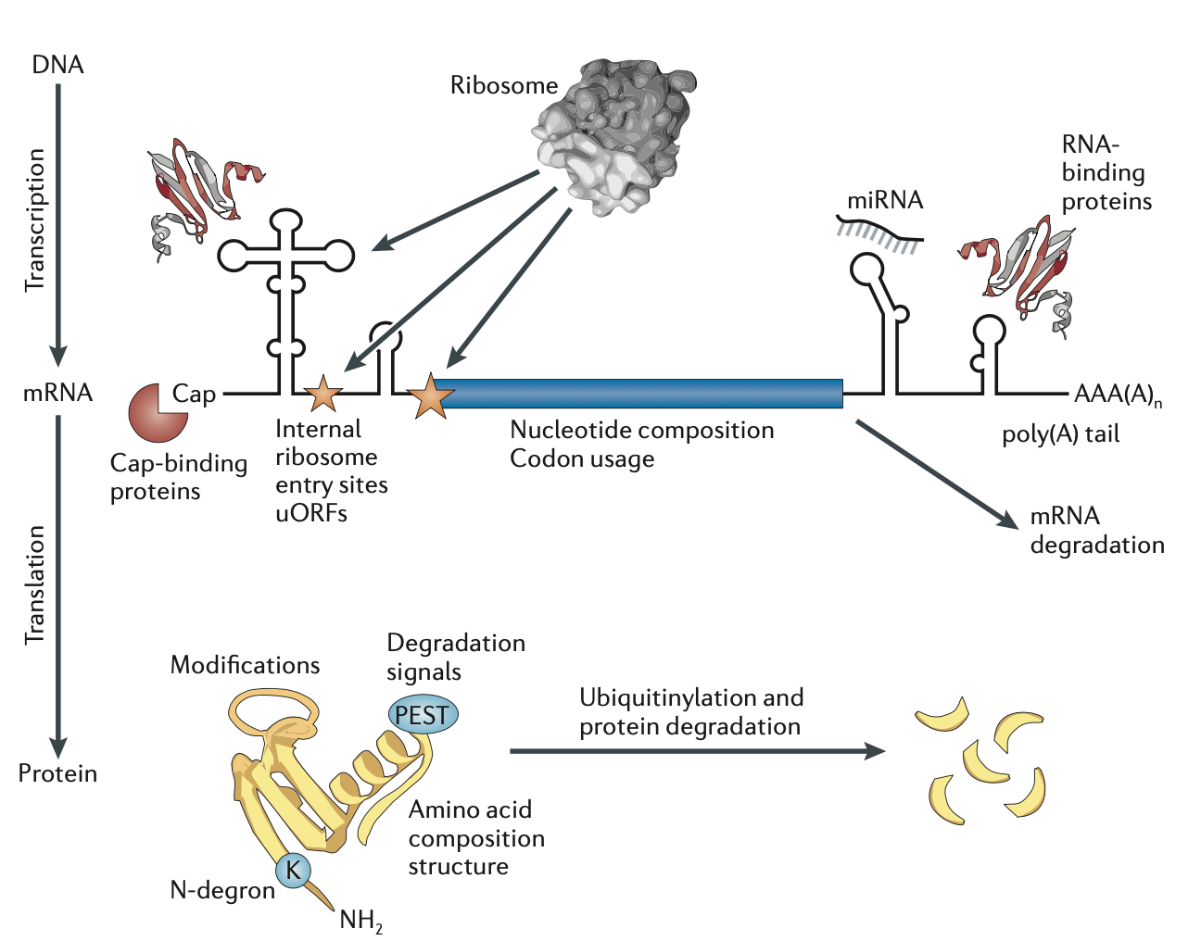
Regulation of protein abundance
Vogel & Marcotte, 2012

Slide 4
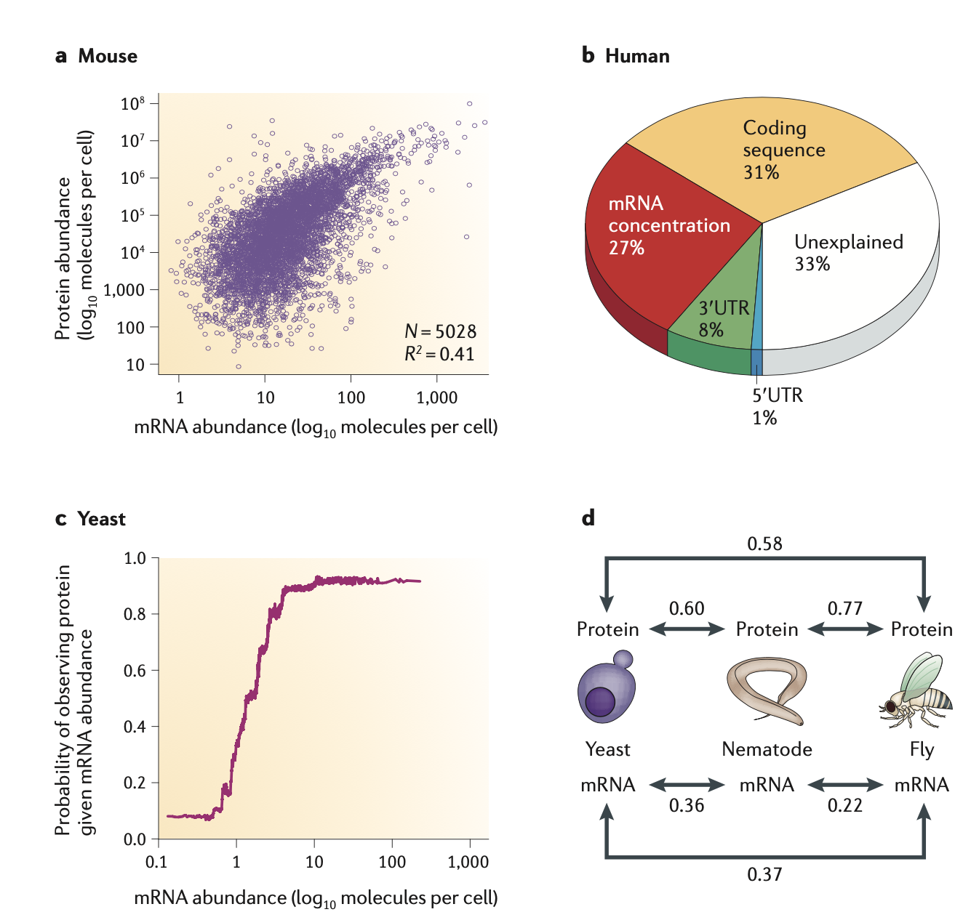
Relationship between mRNA and protein abundances
Vogel & Marcotte, 2012

Slide 5
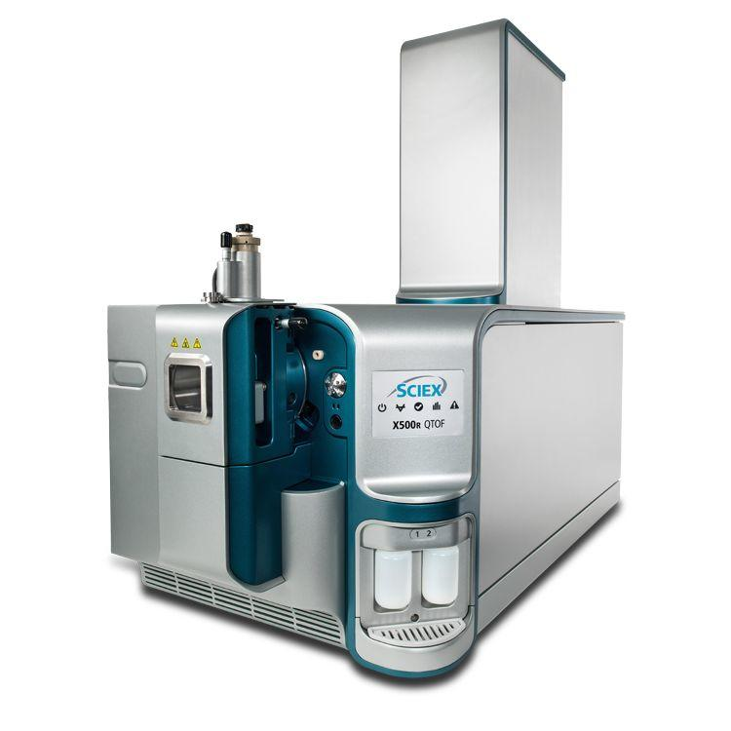
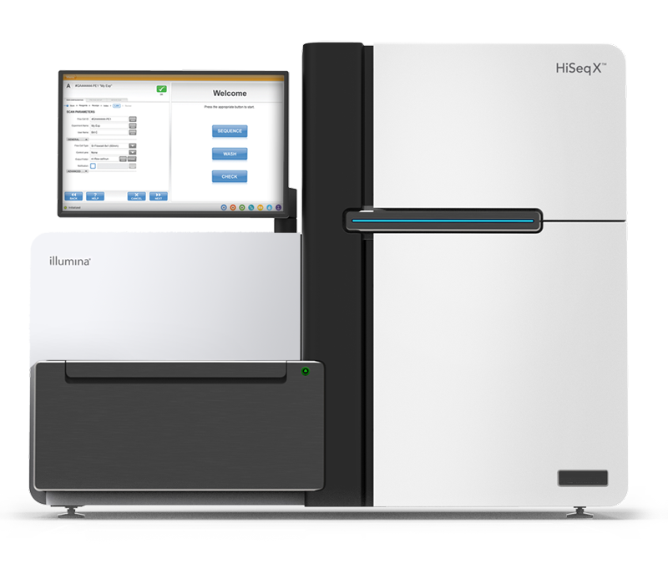
Omics technologies
Next-generation sequencing (NGS)
Mass-spectrometry
epigenomics
genomics
proteomics
metabolomics
Image courtesy: Illumina.com
transcriptomics
Image courtesy: sciex.com

Slide 6
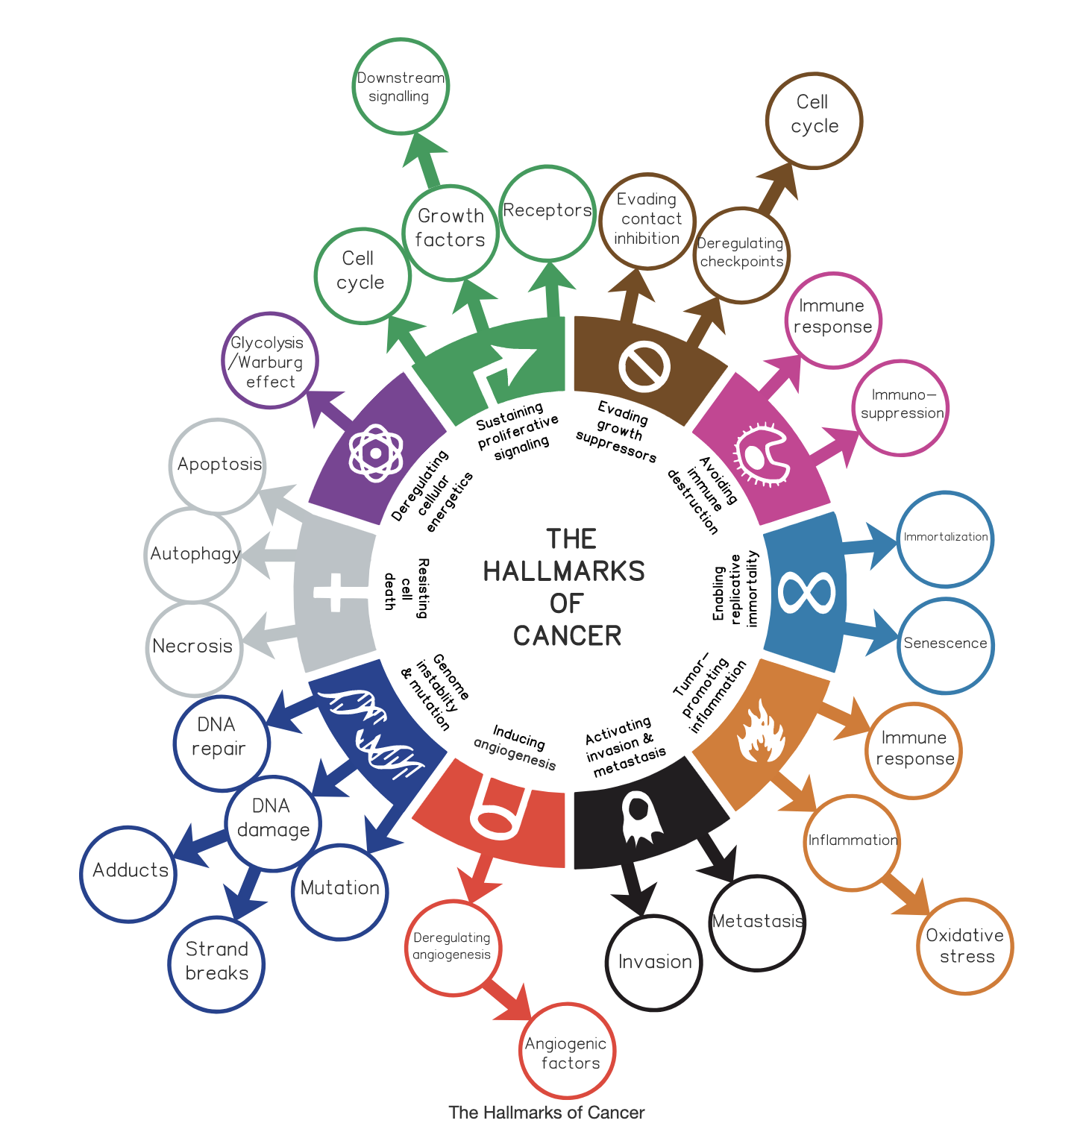
The Hallmarks of Cancer
“Cancer Hallmarks Analytics Tool.” Accessed February 8, 2021. https://chat.lionproject.net/hallmarks.

Slide 7
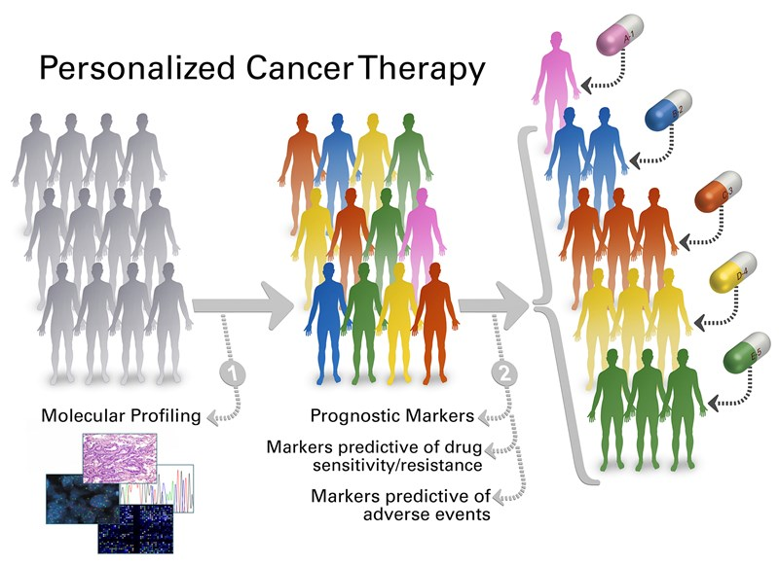
Towards Precision Medicine
Image courtesy: https://pct.mdanderson.org/

Slide 8
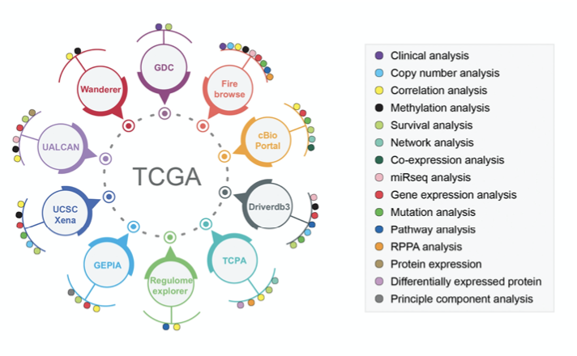
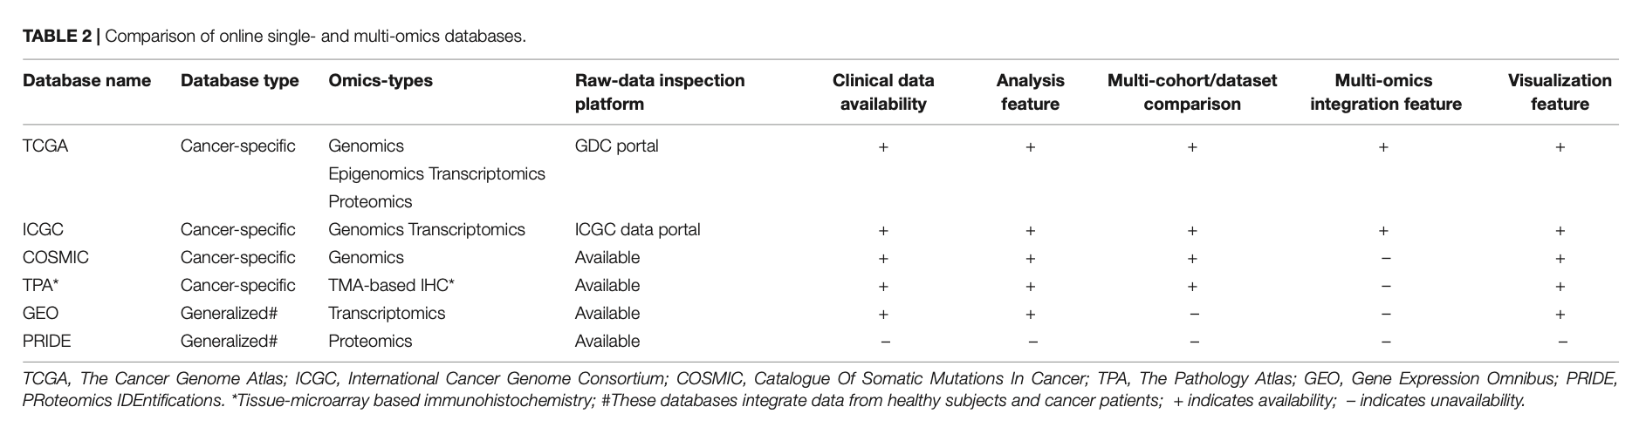
Multi-dimensional online data portals
Das et al., 2020

Slide 9
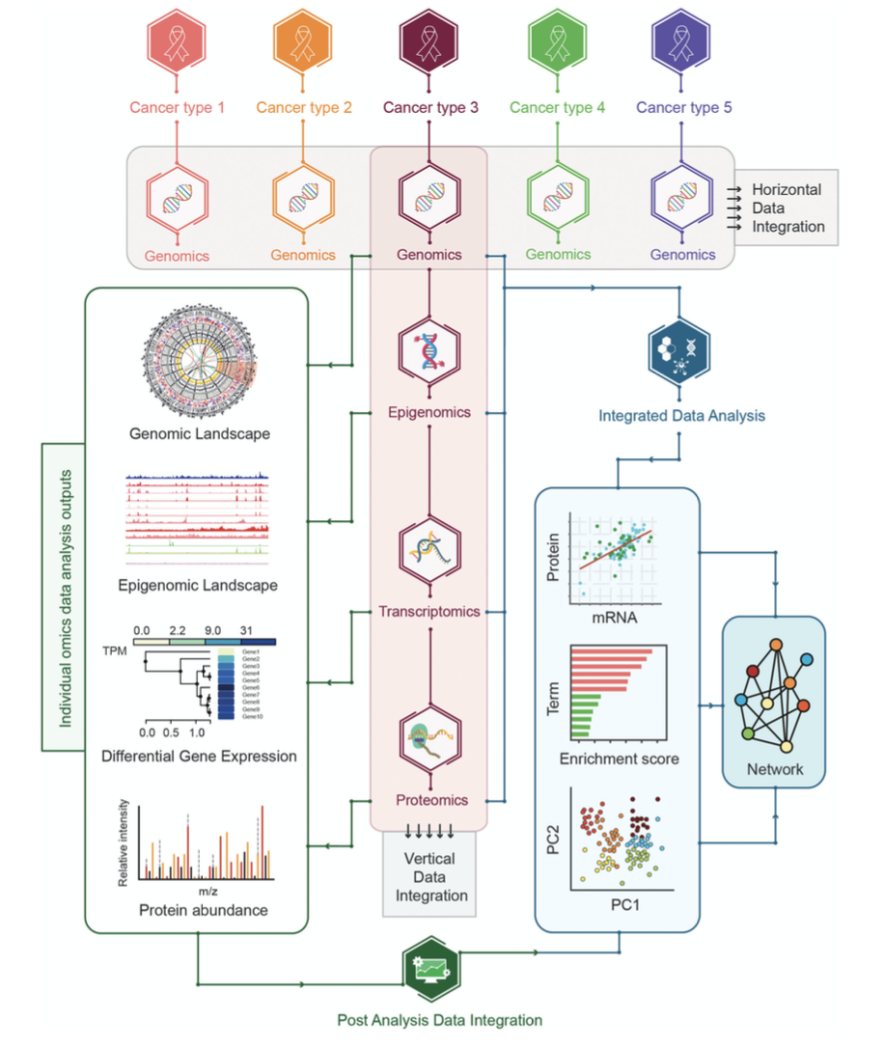
Strategies for multi-omics data integration
Horizontal Data Integration
Vertical Data Integration
Post-Analysis Data Integration
Integrated Data Analysis
Das et al., 2020
Notes:
Ultimate goal: improve stratification & identify biomarkers

Slide 10
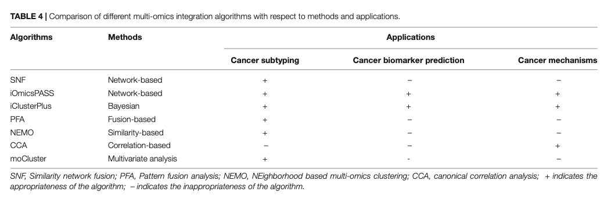
Algorithms for data integration
Network-based
Bayesian
Fusion-based
Similarity-based
Correlation-based
Multivariate analysis
Das et al., 2020

Slide 11
Research goal
Using a multi-omics integration study of transcriptomic and proteomic data, Andrieux et al. aimed at investigating the stability and correlation between mRNA and protein in different murine and human healthy and tumor tissues.

Slide 12
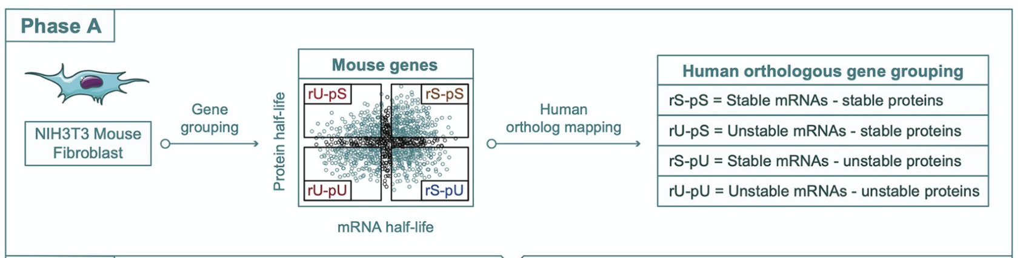
Multi-omics integration pipeline – Phase A
Schwannhausser et al., 2011
 | Stable | Unstable
mRNA | > 10 h | < 8 h
Protein | > 75 h | < 50 h
Andrieux et al., 2020

Slide 13
Datasets for analysis (mRNA and protein abundance data)
 | Dataset 1 | Dataset 2 | Dataset 3 | Cell Line | Tumor and non-tumor
Data | The Genotype Tissue Expression (GTEx) Human Proteome Map (HPM) | Wilhelm et al., 2014 | Wang et al., 2019 | Geiger et al., 2012 | The Cancer Genome Atlas (TCGA) Clinical Proteomic Tumor Analysis Consortium (CPTAC)
Origin | 14 human tissues (adrenal gland, bladder, colon, esophagus, frontal cortex, heart, kidney, liver, lung, ovary, pancreas, prostate, spinal cord, testis) | 12 human tissues (uterus, kidney, testis, pancreas, stomach, prostate, ovary, thyroid gland, adrenal gland, salivary gland, spleen, esophagus) | 29 human tissues (tonsil, liver, spleen, stomach, brain, lung, testis, duodenum, small intestine, urinary bladder, gall bladder, esophagus, heart, thyroid, endometrium, colon, fallopian tube, kidney, smooth muscle, prostate, appendix, pancreas, ovary, placenta, rectum, fat, lymph node, salivary gland, adrenal gland) | 11 human cell lines (A549, GAMG, HELA, HEK293, HEPG2, JURKAT, K562, LNCAP, MCF7, RKO, U2OS) | 58 tumor tissues 41 donor-matched non-tumor colon tissues (mRNA) and 30 non-tumor colon tissues (protein)
Number of genes mapped to stability groups | 4,186 | 3,295 | 4,328 | 4,390 | 2,357

Slide 14
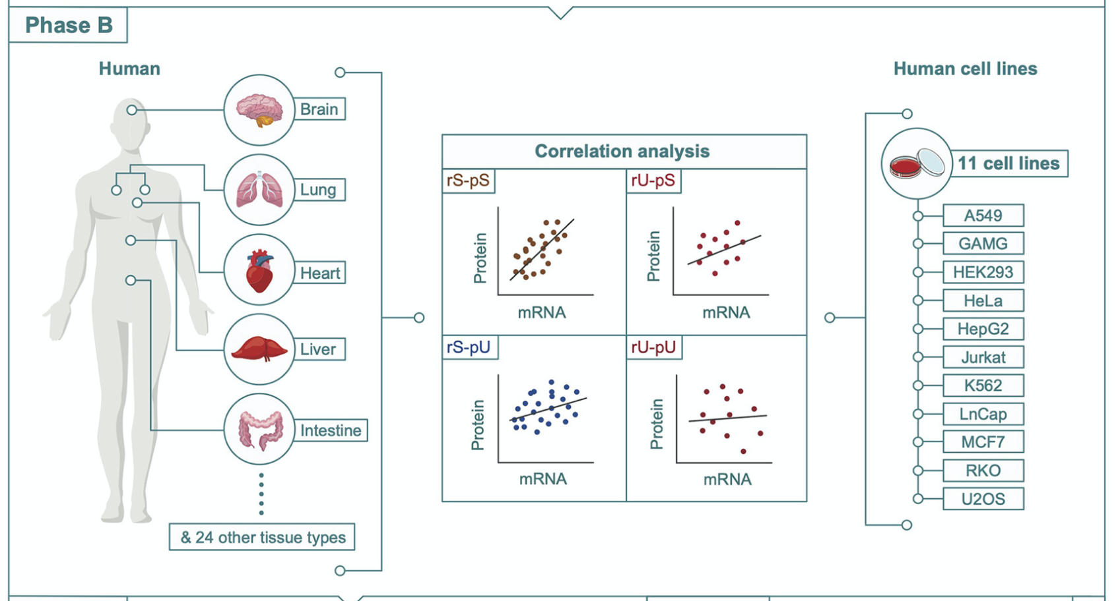
Multi-omics integration pipeline - Phase B
Andrieux et al., 2020

Slide 15
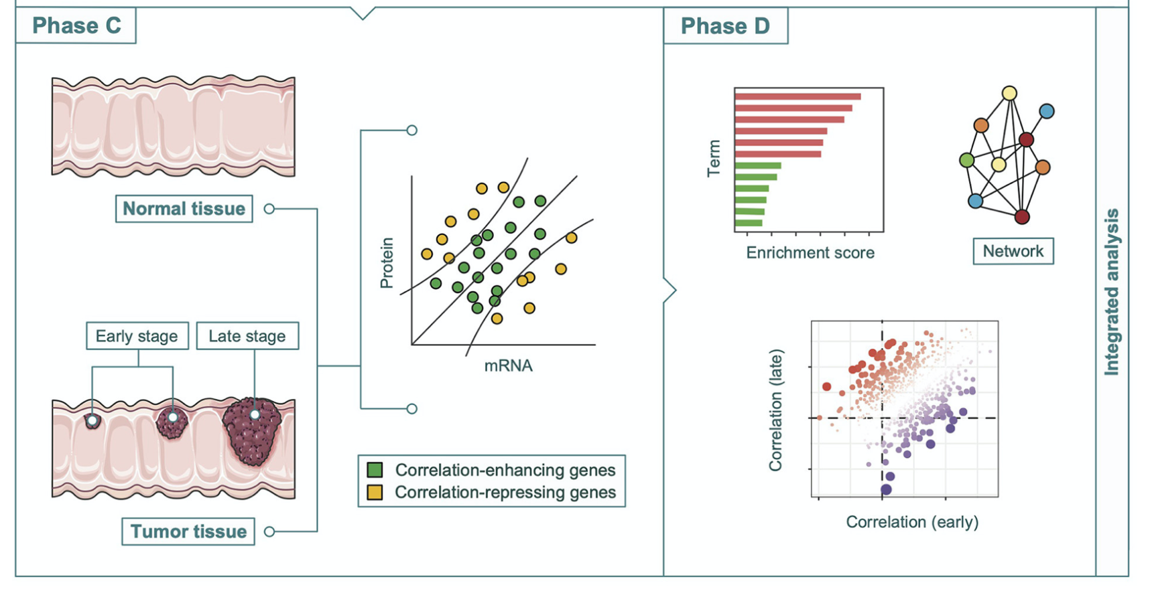
Multi-omics integration pipeline - Phases C & D
Andrieux et al., 2020

Slide 16
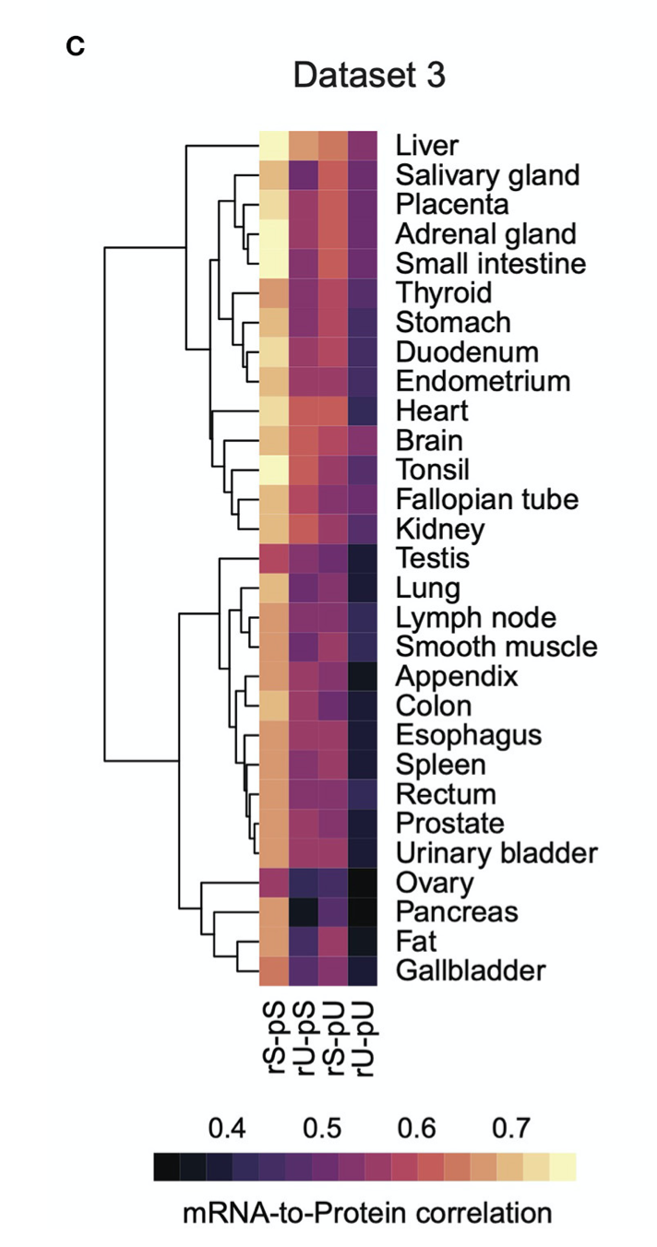
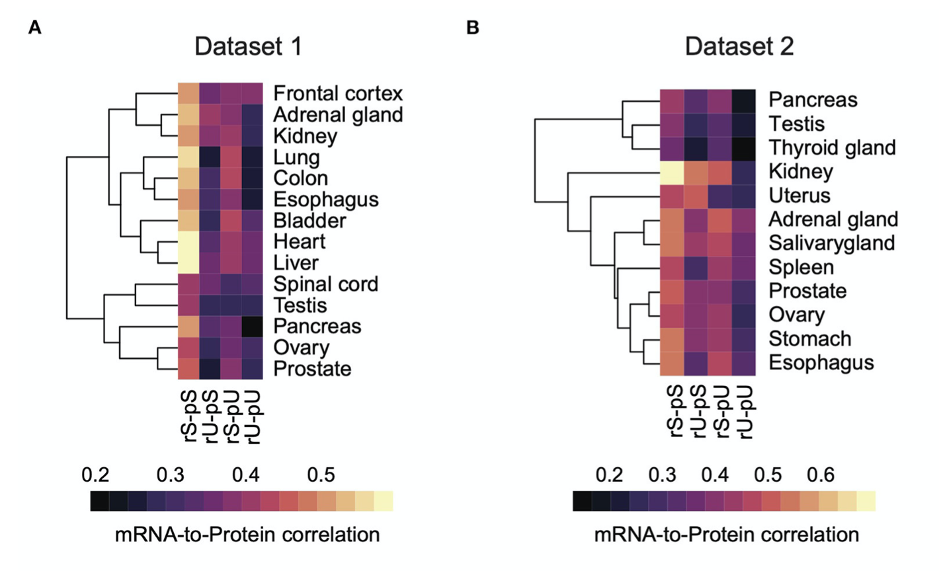
Conserved stability-dependent mRNA-to-protein correlation pattern
Andrieux et al., 2020

Slide 17
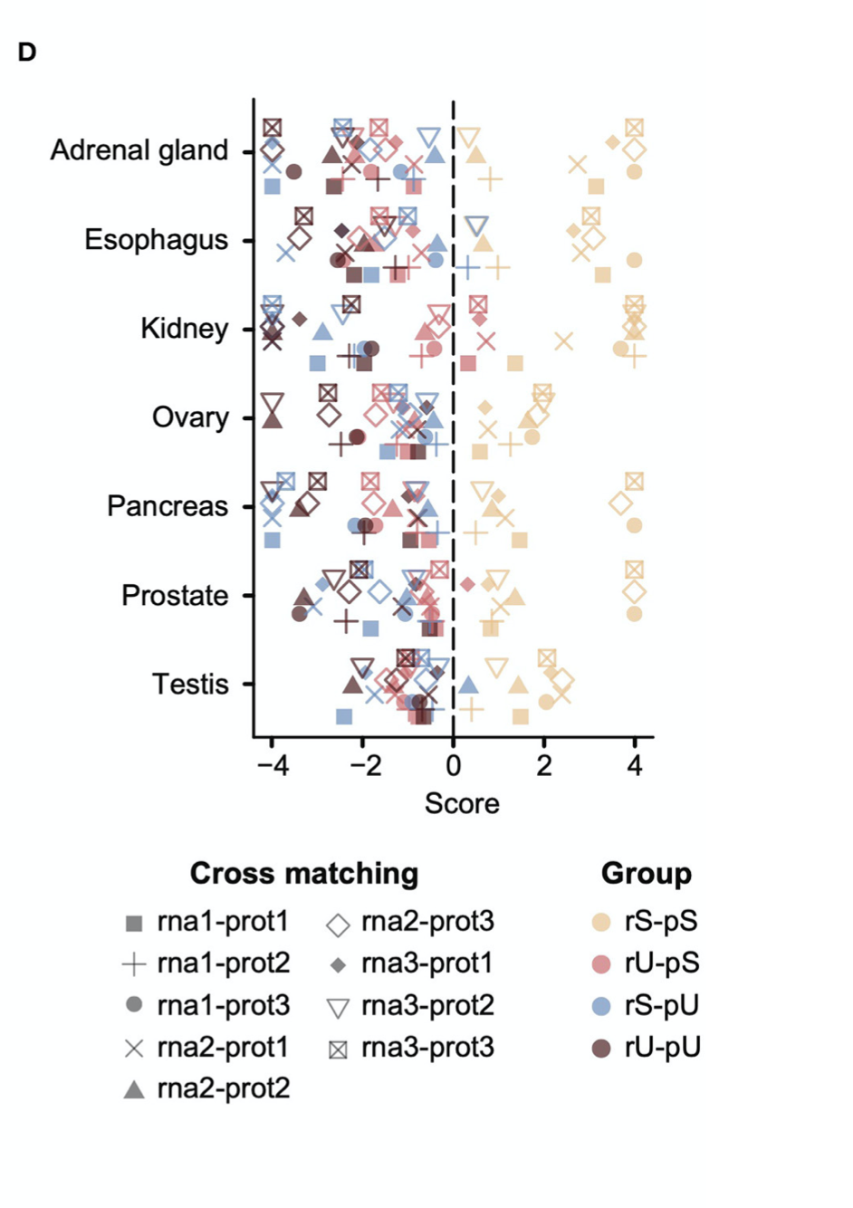
Conserved hierarchical pattern of stability-dependent
mRNA-to-protein correlation
across tissues and datasets
Andrieux et al., 2020

Slide 18
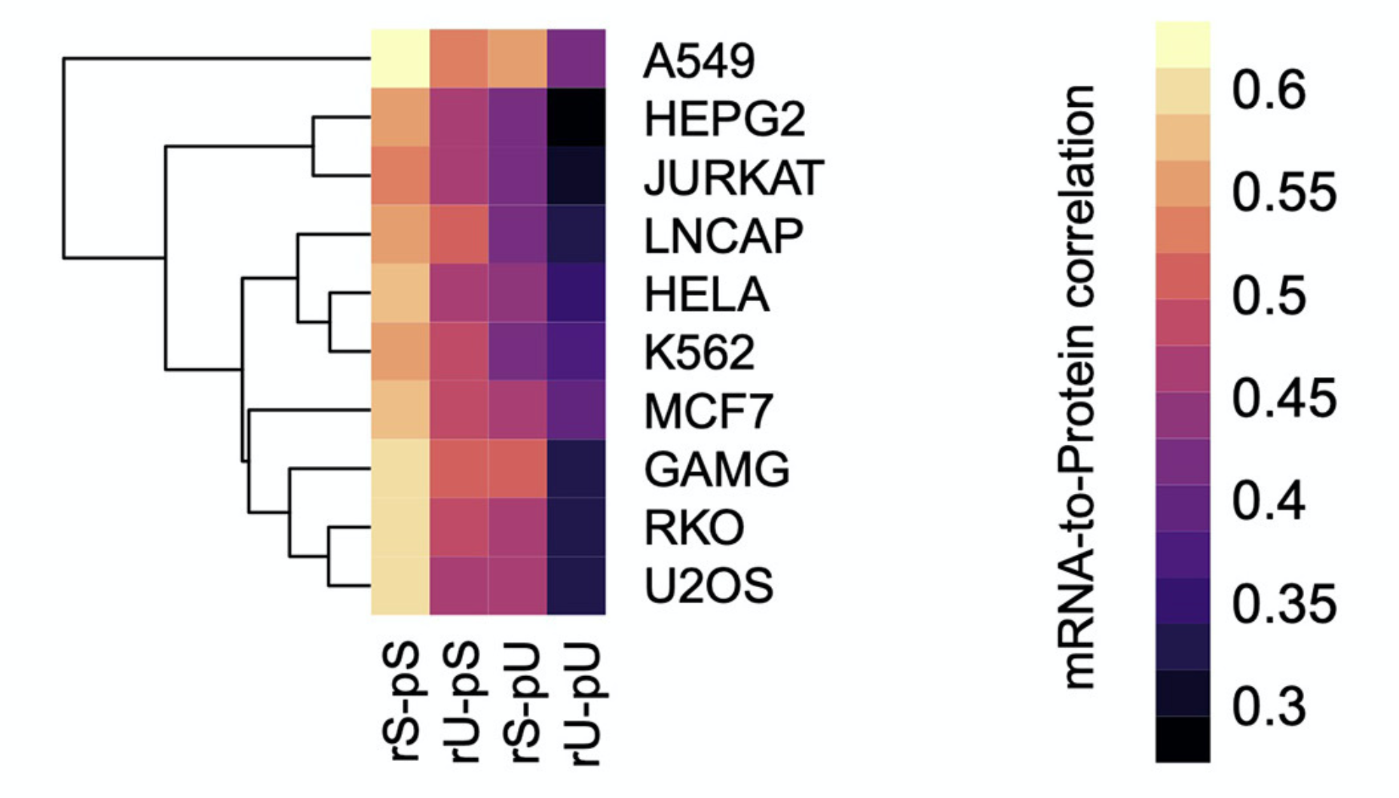
Consistent stability-dependent mRNA-to-protein correlation pattern in human cell lines
Andrieux et al., 2020

Slide 19
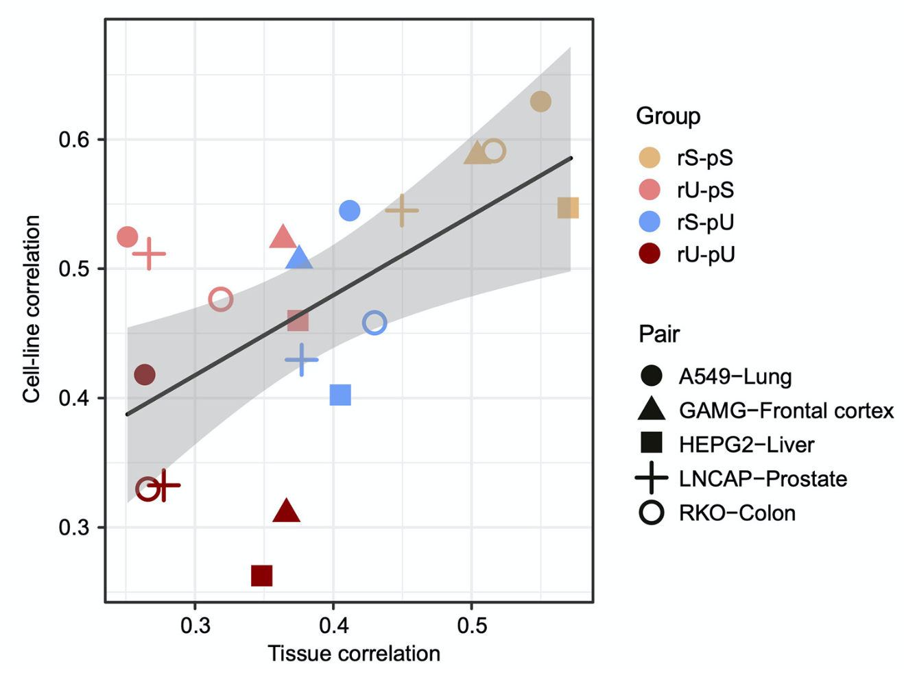
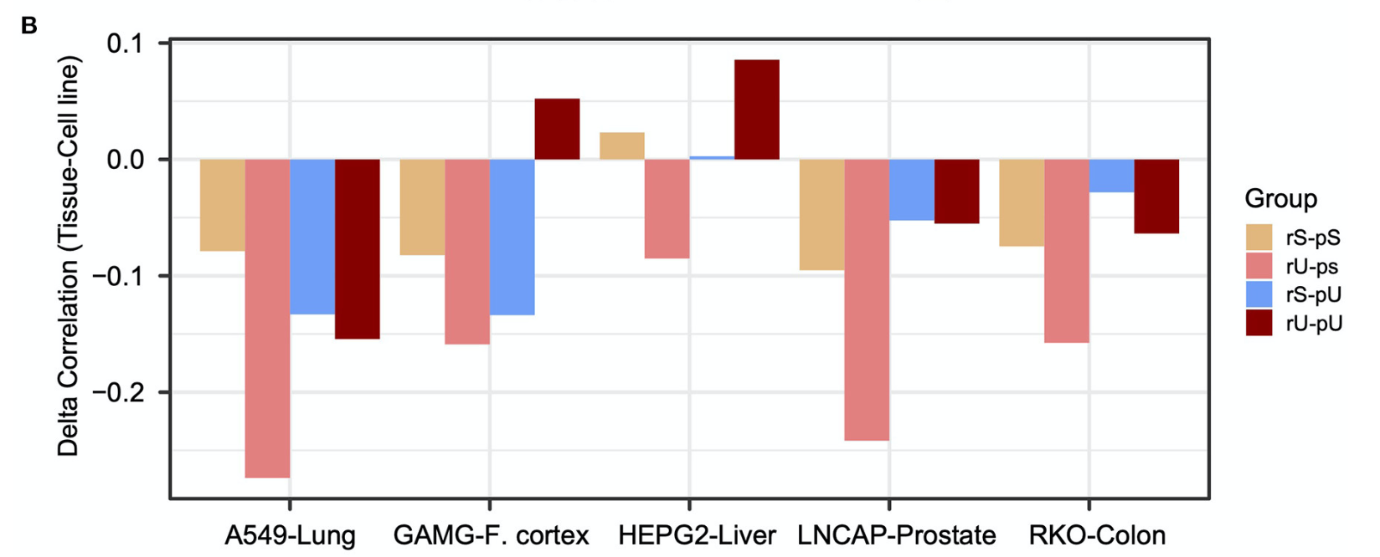
Conserved stability group specific mRNA-to-protein correlation in tissue-paired-cell lines
Andrieux et al., 2020

Slide 20
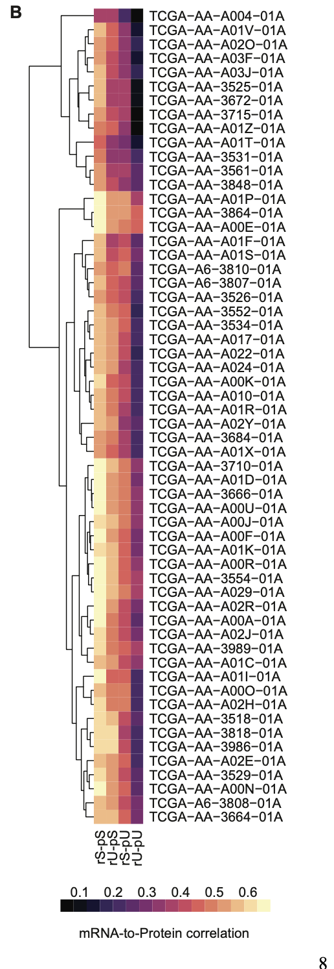
Conserved stability-dependent mRNA-protein correlation pattern across patients
The Cancer Genome Atlas Colon Adenocarcinoma (TCGA-COAD)
Andrieux et al., 2020

Slide 21
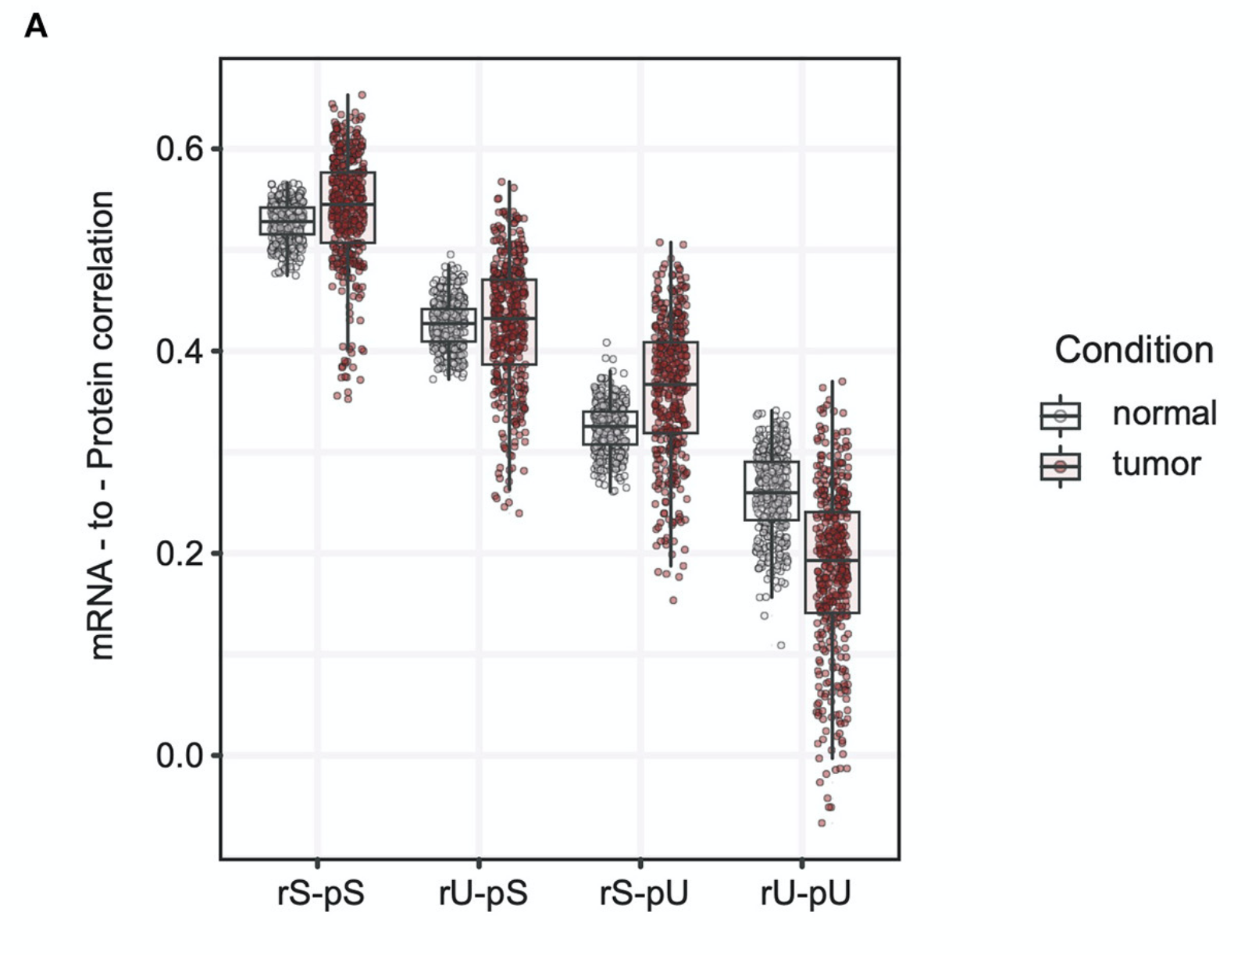
Altered stability-dependent mRNA-to-protein correlation pattern in tumors
Andrieux et al., 2020

Slide 22
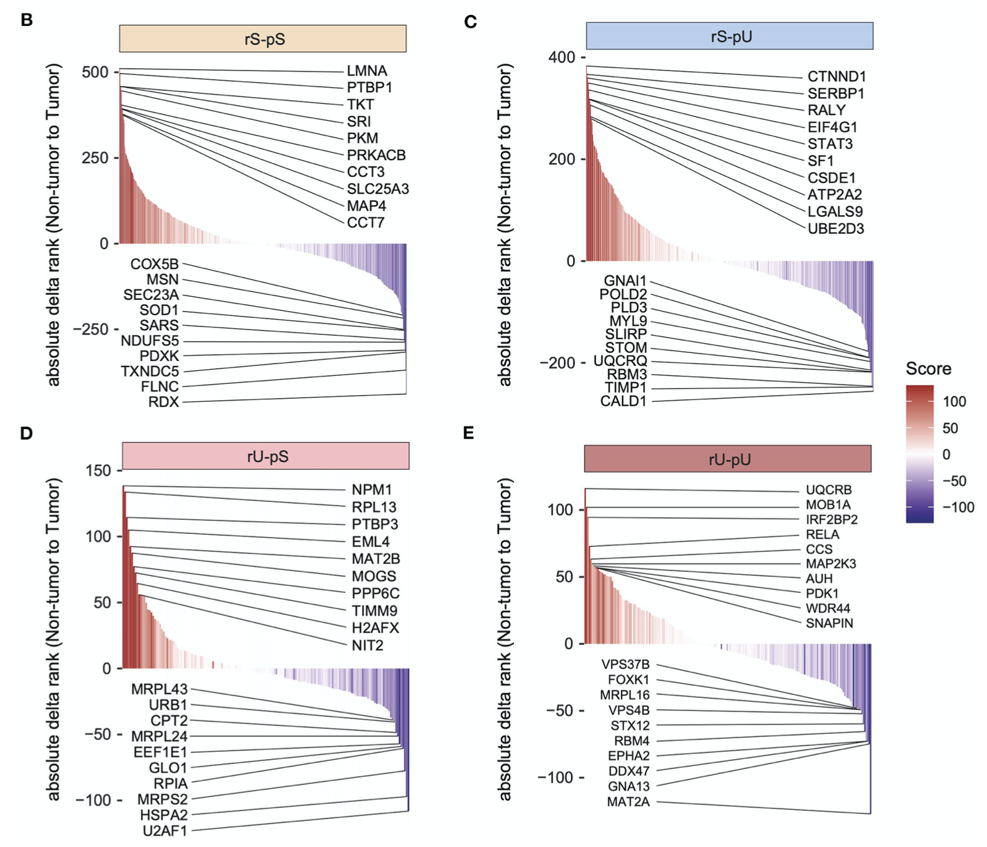
Identification of genes driving mRNA-protein correlation deviation
Stability group | Correlation-enhancing genes | Correlation-repressing genes
rS-pS | PKM (pyruvate kinase) | Cox5B (cytochrome c oxidase subunit 5B)
rS-pU | STAT3
rU-pU | RELA
Andrieux et al., 2020

Slide 23
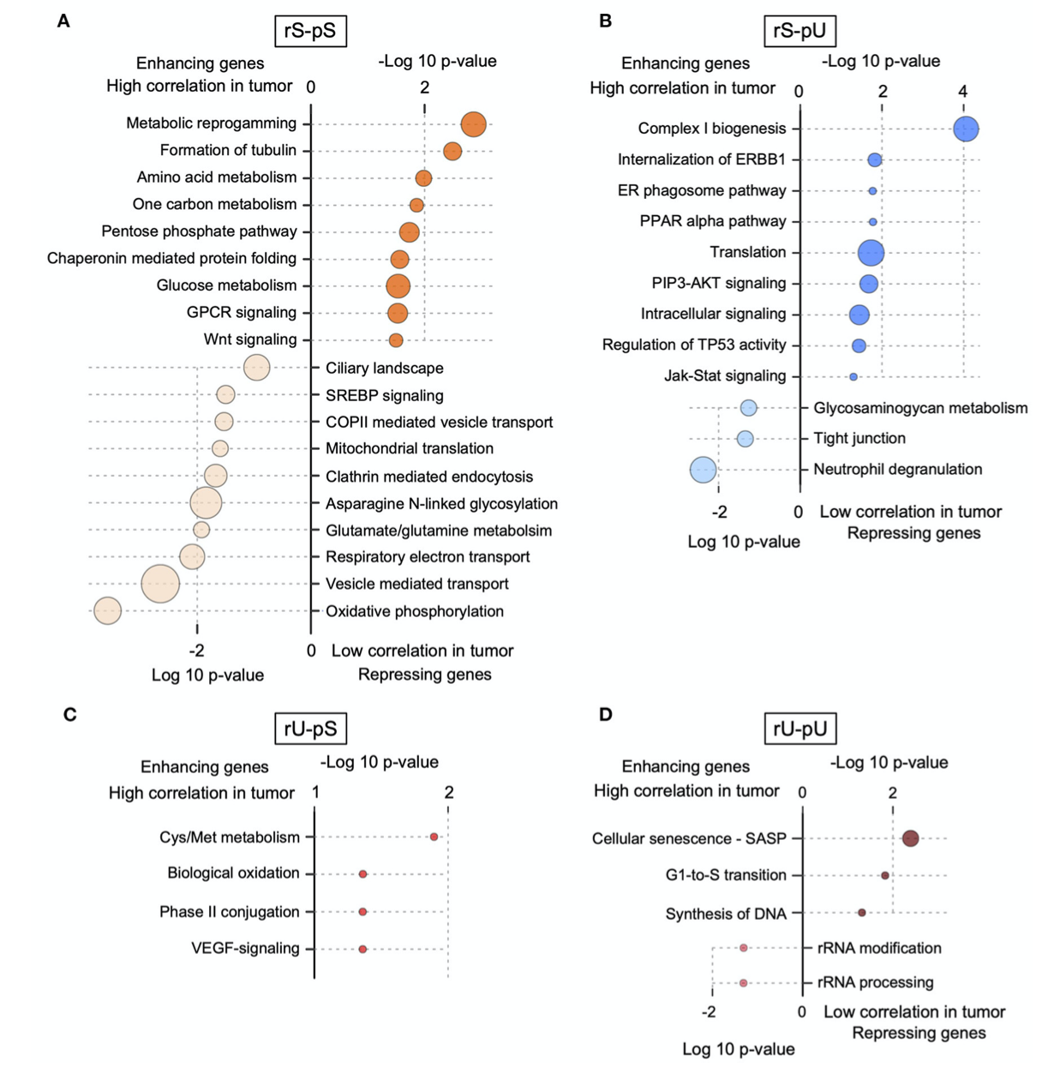
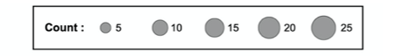
Correlation-enhancing and –repressing genes
Andrieux et al., 2020

Slide 24
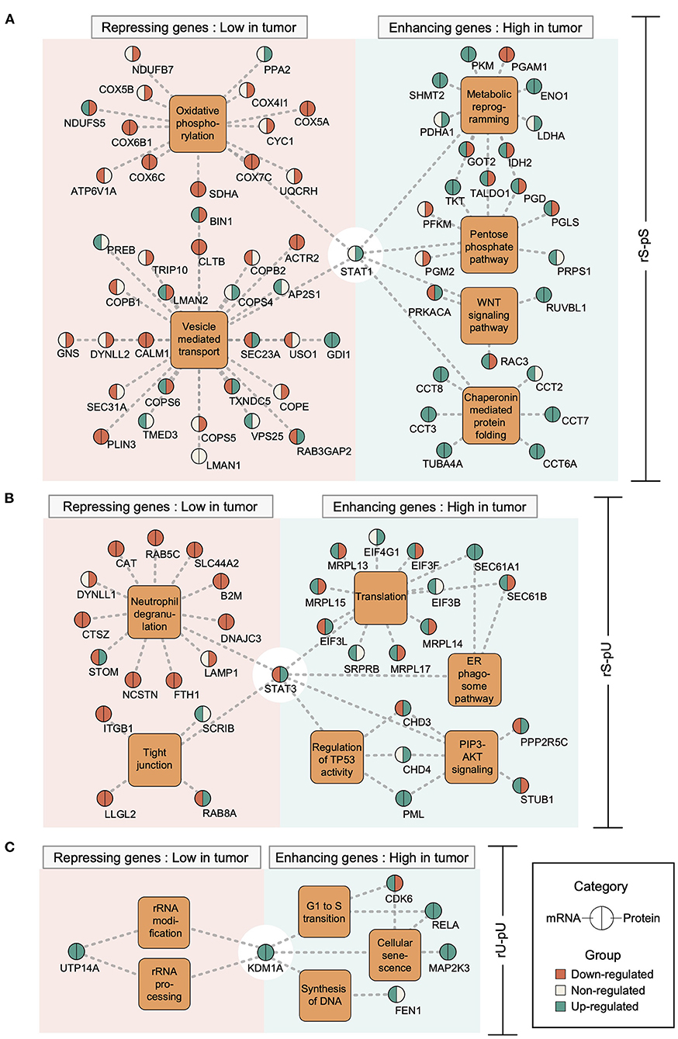
STAT 1 controls correlation-enhancing and –repressing genes
Andrieux et al., 2020

Slide 25
Transcriptional regulatory circuits of correlation-enhancing and –repressing genes
Andrieux et al., 2020

Slide 26
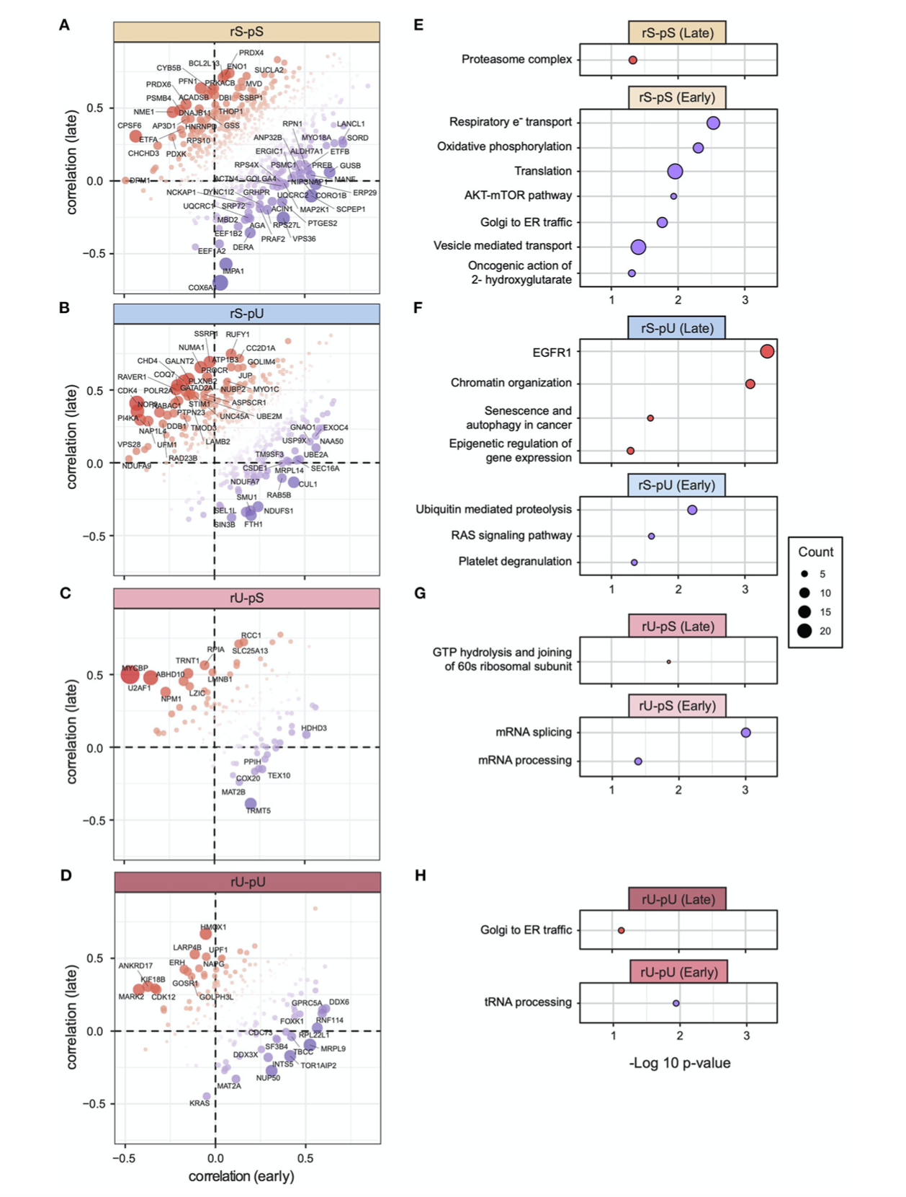
Gene-centric mRNA-to-protein correlation
in early vs. late phases of COAD
Andrieux et al., 2020

Slide 27
Gene-centric mRNA-to-protein correlation
in early vs. late phases of COAD
G
Andrieux et al., 2020

Slide 28
Conclusions
Revealed quantitative relationship between mRNA-to-protein correlation and their stability profiles.
Uncovered conserved pattern of stability-dependent correlation across mammalian species irrespective of tissue type.
Universal rates of mRNA-protein synthesis and degradation in different issues.
Evolutionarily conserved hierarchical patterns of stability-dependent correlation of mRNA-to-protein.
Identified pathways associated with correlation-enhancing and –repressing genes (energy metabolism and respiratory electron transport chain and oxidative phosphorylation)
mRNA-to-protein correlation analysis can serve as a tool to identify cancer-specific transcriptional pathways that are implicated in cancer progression.

Slide 29


Challenges of multi-omics data integration in cancer research
More and more data available
More and more methods
Dealing with sparse datasets
Selecting appropriate controls
Heterogeneity of tumor
Notes:
sc-NGS technologies to combat the latter.
More and more data, more and more methods, more and more challenges.

Slide 30
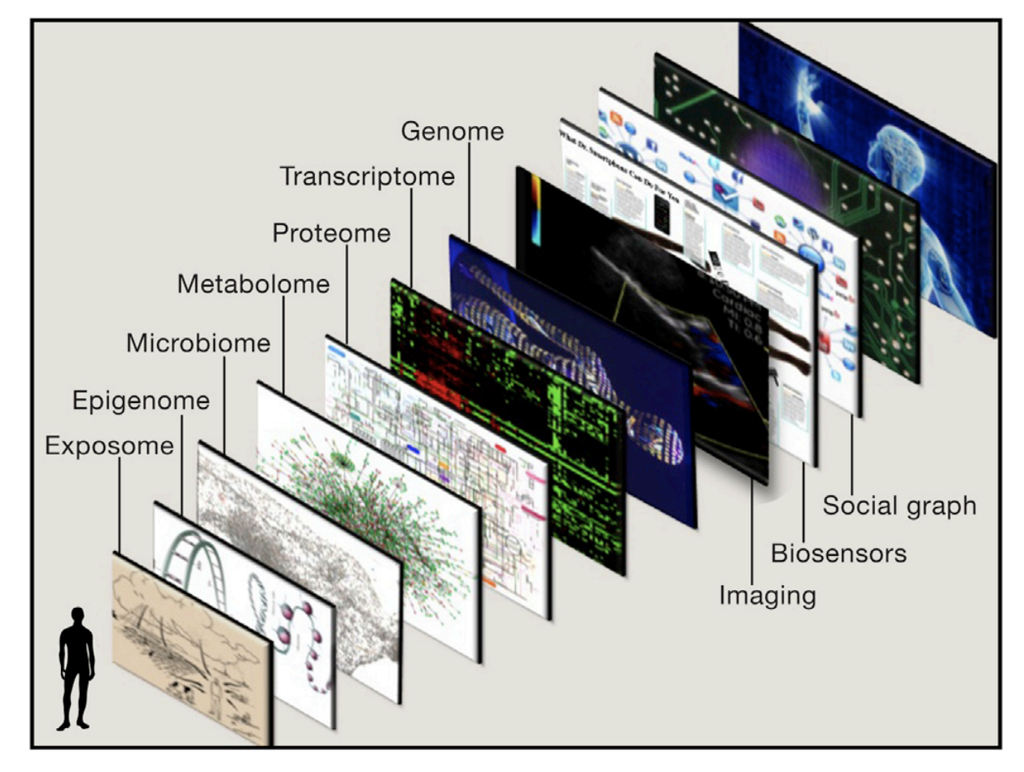
Multi-layer information system of a human being
Topol, 2014
Notes:
there are multiple layers of data that can now be obtained for any individual. This includes data from biosensors, scanners, electronic medical records, social media, and the various omics
Ome means the organic totality of something, some category, or some action.

Slide 31
References
Andrieux, G., Chakraborty, S., Das, T., & Boerries, M. (2020). Alteration of Proteotranscriptomic Landscape Reveals the Transcriptional Regulatory Circuits Controlling Key-Signaling Pathways and Metabolic Reprogramming During Tumor Evolution. Frontiers in Cell and Developmental Biology, 8, 586479. https://doi.org/10.3389/fcell.2020.586479
Das, T., Andrieux, G., Ahmed, M., & Chakraborty, S. (2020). Integration of Online Omics-Data Resources for Cancer Research. Frontiers in Genetics, 11. https://doi.org/10.3389/fgene.2020.578345
Topol, E. J. (2014). Individualized Medicine from Prewomb to Tomb. Cell, 157(1), 241–253. https://doi.org/10.1016/j.cell.2014.02.012
Vogel, C., & Marcotte, E. M. (2012). Insights into the regulation of protein abundance from proteomic and transcriptomic analyses. Nature Reviews Genetics, 13(4), 227–232. https://doi.org/10.1038/nrg3185

